Slide 1

INCRETINAS: NUEVAS ESTRATEGIAS CONTRA LA DMT2
Zaragoza, 16 de abril del 2012
Acisclo Pérez Martos

Slide 2
RESUMEN
INTRODUCCION A LA DMT2 Y COMPLICACIONES DIVERSAS
PATOGENESIS , FISIOPATOLOGIA
TRATAMIENTO ACTUAL DE LA DMT2 Y PROBLEMAS A RESOLVER
HORMONAS QUE CONTROLAN LA GLUCEMIA
INCRETINAS: PERSPECTIVAS HISTORICAS
INCRETINAS COMO COMPONENTES DE LA FAMILIA DEL GLUCAGON
SECRECIÓN DE INSULINA POR GLUCOSA Y POR INCRETINAS
FUNCIONES DE LAS INCRETINAS (CARDIOVASCULARES)
DPP-4
TERAPIA BASADA EN INCRETINAS

Slide 3
¿QUE ES LA DIABETES MELLITUS TIPO 2?
  Enfermedad metabólica progresiva con hiperglucemia, como consecuencia
de una combinación de resistencia a la insulina y a una inadecuada respuesta
secretora de insulina (OMS calcula 340 millones de diabéticos. Mas del 60% muere
por complicaciones cardiovasculares)
  En la DMT2 están implicados dos procesos patológicos
    Deterioro progresivo de las función de los islotes pancreáticos
    Disminución de la respuesta de los tejidos a la insulina (resistencia a la insulina)

Slide 4
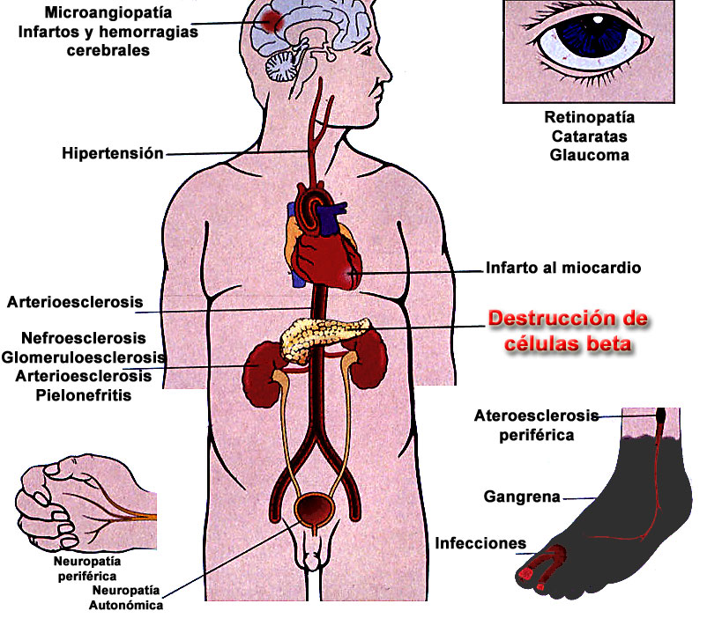
COMPLICACIONES DE LA DMT2
Alta incidencia
macrovascular
Complicaciones
microvasculares

Slide 5


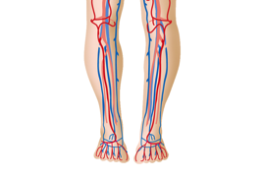


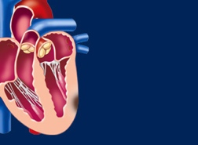

Incidencia de complicaciones clínicas asociadas con la glucemia
(PSG = Proteínas Séricas Glucosiladas)
Valores máximos de 6-7%
mas del 60% tiene valores mas elevados
Complicaciones microvasculares (nefropatía, ceguera)*
37%
Amputación o afección severa de vasos periféricos *
43%
HbA_{1c}
1%
21%
Muertes relacionadas con DM*
14%
IAM*
* p<0.0001
** p=0.035
12%
Ictus**
Stratton IM et al. BMJ 2000;321: 405 – 412

Slide 6
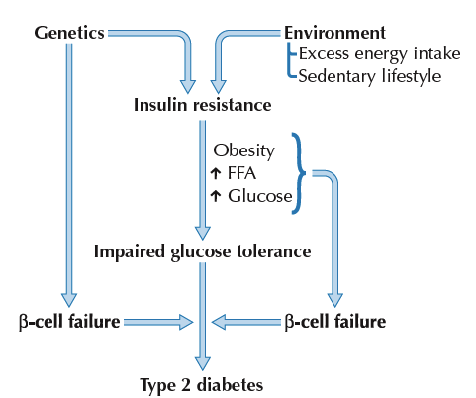
Patogénesis de Diabetes Mellitus tipo 2

Slide 7
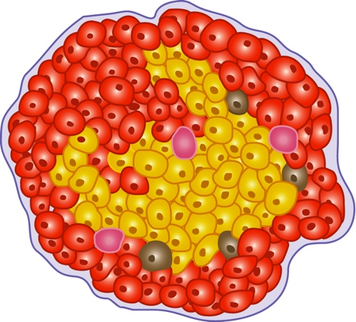
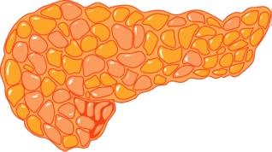
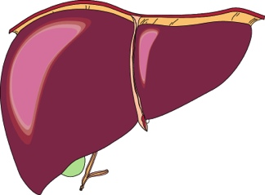

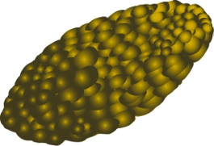
Fisiopatología de la Diabetes Mellitus tipo 2
Islote
Déficit de insulina
Páncreas
célula beta
produce
menos insulina
célula alfa
produce exceso de glucagón
Exceso de
glucagón
Menos
insulina
Menos
insulina
Hiperglucemia
Músculo y grasa
Hígado
Producción excesiva
de glucosa
Resistencia a la insulina (menor captación de glucosa)
Buse JB et al. In Williams Textbook of Endocrinology. 10th ed. Philadelphia, Saunders, 2003:1427–1483; Buchanan TA Clin
Ther 2003;25(suppl B):B32–B46; Powers AC. In: Harrison’s Principles of Internal Medicine. 16th ed. New York: McGraw-Hill, 2005:2152–2180;
Rhodes CJ Science 2005;307:380–384.

Slide 8
TERAPIAS ACTUALES CONTRA LA DMT2
Elevar los niveles de insulina:
    Administración directa de insulina
    Agentes orales que favorecen la secreción
Mejorar la sensibilidad de los tejidos por la insulina
Reducir la absorción de carbohidratos en el tracto intestinal
Reducción la liberación de glucosa hepática
Absorción de HC
Inh. α-glucosidasas
Glitazonas Metformina
Aumento producción hepática
de glucosa
Descenso captación
Muscular glucosa
Hiperglucemia
Metformina
Glitazonas
Biguanidina
Secreción inapropiada
de insulina
Sulfonilureas
Meglitinidas
Insulina

Slide 9
PROBLEMAS SIN RESOLVER QUE ACTUALMENTE ESTAN EN INVESTIGACIÓN
(potenciales dianas para futuras terapias)
1.- Sensibilidad reducida de las células β por la glucosa (Sensor de glucosa)
2.- Pérdida de función y número de las células β (progreso de la enfermedad)
3.- Pérdida de secreción de insulina
4.- Pérdida de respuesta a la insulina a las oscilaciones de la concentración de glucosa
5.- Ratio elevada de Proinsulina / Insulina
6.- Secreción aumentada de Glucagón (aumento de glucosa)
7.- Secreción anormal de amilina (reduce la concentración de glucosa postprandial)
8.- Enlentecimiento del vaciado gástrico (facilita de reducción de la ingesta y peso corporal)
9.- Reabsorción renal de glucosa (SGLT2) (Mas del 40% de glucemia procede del riñón)
Algunos de estos problemas se intentan resolver con la terapia de incretinas

Slide 10
Necesidades de la glucosa
120 g para el cerebro
160 g de glucosa diarios
40 g para el resto del organismo
Disponibilidad de glucosa
En líquidos corporales 20 g de glucosa
Procedente del glucógeno 190 g de glucosa
SOLAMENTE HAY RESERVAS GLUCÍDICAS PARA UN DIA

Slide 11
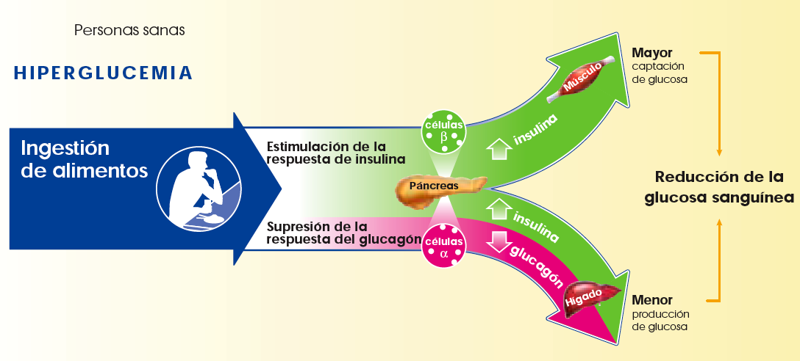
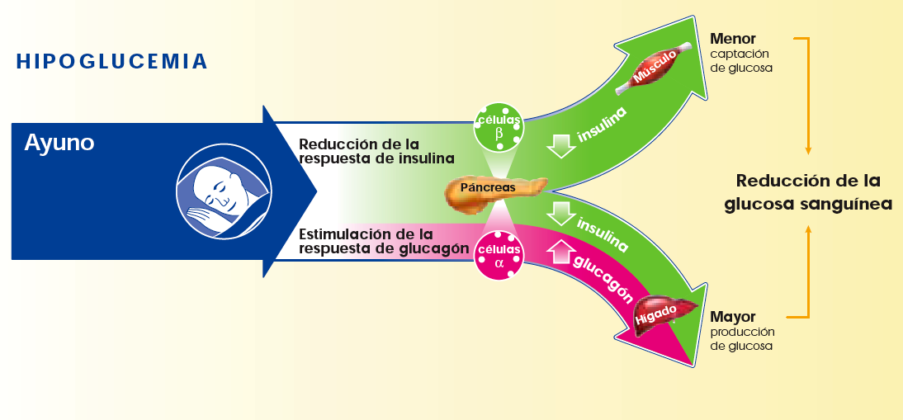
Insulina y glucagón regulan la homeostasis de la glucosa
¿¿¿¿¿¿

Slide 12
Dinámica de insulina y glucagón en respuesta al alimento en sujetos normales y diabéticos tipo 2
20.0
Meal
18.3
Glucose
(mmol/l)
16.6
15.0
Type 2 diabetes
13.3
6.1
Normal subjects
4.4
120
Insulin
(mU/l)
90
60
Delayed/depressed
insulin response
30
0
140
Nonsuppressed
glucagon
130
Glucagon
(ng/l)
120
110
100
90
-60
0
60
120
180
240
Time (min)
Normal subects n=11; Type 2 diabetes n=12
Müller et al. N Engl J Med. 1970
Notes:
Insulin and glucagon dynamics in response to meals in normal subjects and Type 2 diabetes
This slide illustrates a study that measured plasma glucose, insulin, and glucagon response in individuals without (normal subjects) and with Type 2 diabetes. The study was conducted after an overnight fast followed by a high-carbohydrate meal.
Plasma glucose concentrations rose from 12.7 mmol/l (228 mg/dl), pre-meal, to 19.9 mmol/l (358 mg/dl) in individuals with Type 2 diabetes compared with an increase from 4.7 mmol/l (84 mg/dl) to a peak of 7.6 mmol/l (137 mg/dl) in normal subjects.
Insulin levels rose in normal individuals from a fasting level of 13 mU/l to a peak of 136 mU/l at 45 minutes. The insulin response in individuals with Type 2 diabetes was depressed, with a modest increase from a fasting level of 21 mU/l to a peak of 50 mU/l at 60 minutes.
In normal individuals, plasma glucagon began to fall from the fasting value of 126 ng/l (126 pg/ml) within 30 minutes of the start of the meal and reached a significantly lower concentration of 90 ng/l (90 pg/ml) at 90 minutes (P<0.01). Plasma glucagon concentrations in those with Type 2 diabetes did not fall in response to the meal, despite the sharp increase in plasma glucose.
These results demonstrate the delayed and suppressed insulin response to rising plasma glucose concentrations in individuals with Type 2 diabetes. Importantly, it also shows the lack of postprandial suppression of glucagon in Type 2 diabetes following a meal; this stands in marked contrast to the rapid fall in glucagon levels among normal subjects. The combined effect of decreased insulin secretion and glucagon over-secretion in Type 2 diabetes leads to fasting hyperglycaemia and increases postprandial hyperglycaemia.
REFERENCE
Müller WA, Faloona GR, Aguilar-Parada E, Unger RH. N Engl J Med. 1970;283:109-115.

Slide 13
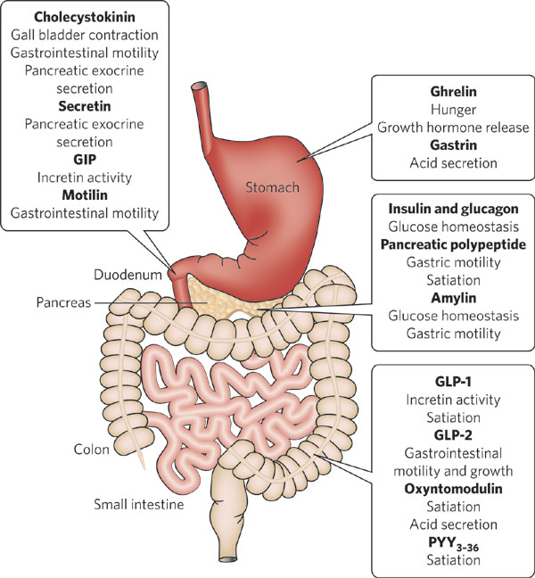

Slide 14
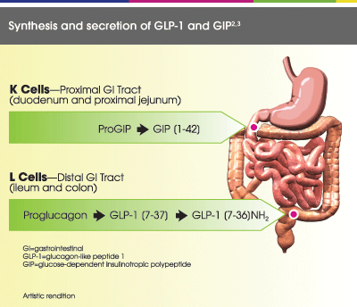

Slide 15
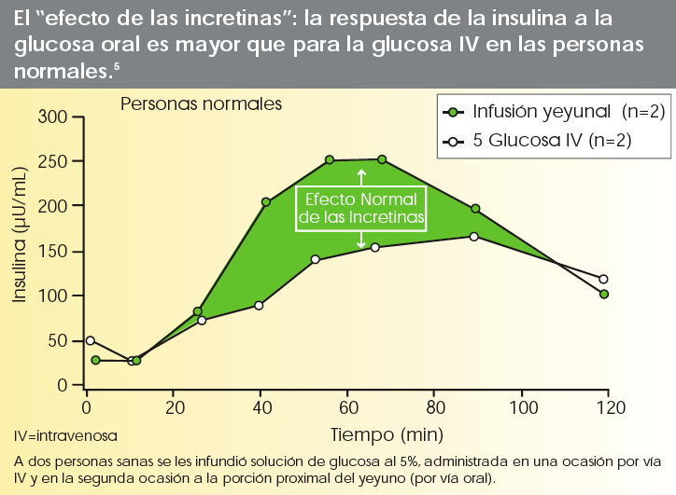
INtestinal seCRETion of INsulin
Sustancias derivadas de los intestinos, que se liberan tras la
ingestión oral de nutrientes y aumentan la liberación de insulina

Slide 17
PERSPECTIVAS HISTÓRICAS
8%
Demostración del GIP es una incretina.
En humanos el GIP (Peptido Inhibidor Gastrico) se cambia a Peptido Insulinotropico dependiente de Glucosa
Definición efecto incretina
Actividad hormonal del intestino que aumenta la secreción pancreática
La encima DPP-4 degrada GIP y GLP-1
Llevó al desarrollo de fármacos contra la DMT2
1902
1932
1964
1973
1987
1995
2000
1ª Observación efecto incretina
Un factor intestinal estimula secreción pancreática
Demostración del efecto de las incretinas.
La glucosa por vía oral produce mas efecto que por vía IV
Demostración que GLP-1 es una incretina humana
En humanos se demuestra una 2ª hormona intestinal análoga al Glucagon
Investigación en curso de:
  Inhibidores de DPP-4
  Simuladores de incretinas

Slide 18
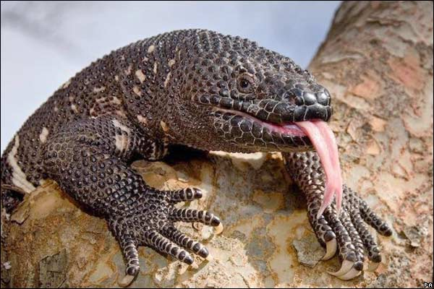
Pertenecen a una superfamilia de péptidos del Glucagón por lo
que tienen homología en su secuencia de aminoácidos (21 y 48%)
(Intestino, Páncreas, S. Nervioso. Gran variedad de funciones)
GLUCAGON
SECRETINA
VIP
GIP
PHI
PHM
GHRH
GLICENTINA
GLP-1 (7-37)
GLP-1 (7-36)AMIDA
GLP-2
OXINTOMODULINA
PACAP 27-38 (Péptido activador de adenilato ciclasa) (de ovino)
PEPTIDOS AISLADOS DE VENENO DE LAGARTOS
(Monstruo de Gila)
HELODERMINA
HELOSPECTINA I
HELOSPECTINA II
EXENDINA 3
EXENDINA 4 (53% homologia con GLP-1, agonista)
EXENDINA (9-39) (Antagonista)

Slide 19
Expresión del gen pre-proglucagon: 6 Exones (E1 – E6)
5 Intrones (IA – IE)
No splicing alternativo
M = Metionina Inicio Traducción
UN-TX = No traducida
Procesamiento posttraduccional
por enzimas Prohormona Convertasas (PC)
Diferencias de procesamiento
Numerosas hormonas peptídicas multifuncionales implicadas en el metabolismo de nutrientes

Slide 20
Las incretinas
GLP-1: Glucagón-Like Peptide 1
A
G
F
S
V
S
L
G
A
H
E
T
T
D
S
Y
E
Q
A
45% de homología
R
K
L
A
F
K
G
G
V
W
I
E
GIP: Gastric Inhibitory Polypeptide
Glucose-Dependent Insulinotropic Polypeptide
A
G
F
S
Y
I
M
K
H
Y
E
T
I
D
S
A
D
I
Q
D
K
G
K
A
L
N
F
Q
W
N
K
Q
L
W
V
D
K
T
H
N
I
Q
35% homología
Amino acids shown in are homologous with the structure of glucagon.
MORADO
Drucker. Diabetes Care. 2003;26:2929
Notes:
Major discussion point:
There have been 2 important incretins identified thus far: GLP-1 (glucagon-like peptide 1) and GIP (originally “gastric inhibitory polypeptide,” but it was later determined that GIP did not inhibit gastric function and the name was changed to “glucose-dependent insulinotropic polypeptide,” retaining the GIP acronym).
Both of these peptides share amino acid sequences similar to those found in glucagon.
Drucker DJ. Enhancing incretin action for the treatment of type 2 diabetes. Diabetes Care. 2003;26:2929-2940.

Slide 21
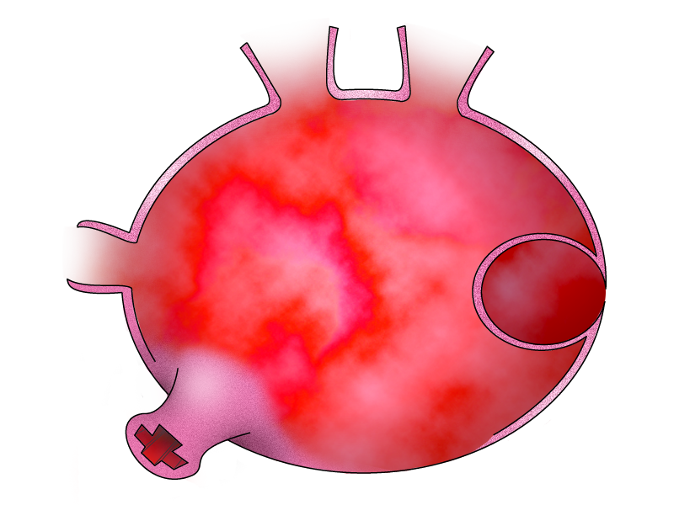


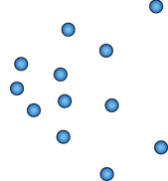
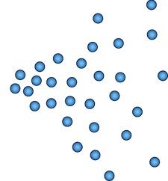

La glucosa estimula la secreción de insulina
Ca²⁺
Glucosa
Canal de K/ATP
Canal de Ca²⁺ voltaje-dependiente
↑ATP/ADP
Transportador de glucosa
Liberación de insulina
Gránulos de insulina
Receptor de GLP-1
Célula β Pancreática
Gromada J, et al. Pflugers Arch – Eur J Physiol. 1998;435:583-594.; MacDonald PE, et al. Diabetes. 2002;51:S434-S442.
Notes:
DISCUSSION
The basic glucose-stimulated insulin secretion pathway involves the following steps:
Glucose enters the cell through the glucose transporter
Glucose metabolism causes a rise in intracellular ATP and a decrease in intracellular ADP, resulting in an increase in the ATP/ADP ratio
This increase in the ATP/ADP ratio causes the ATP sensitive K channels to close, causing a depolarisation of the plasma membrane
The depolarisation activates voltage-dependent Ca²⁺ channels, allowing influx of Ca²⁺
The increased Ca²⁺ stimulates the exocytosis of insulin granules
Abbreviations
ADP = adenosine diphosphate
ATP = adenosine triphosphate
Ca²⁺ = calcium
cAMP = cyclic adenosine monophosphate
K = potassium

Slide 22

Se libera una cantidad limitada de insulina en respuesta a la estimulación del receptor de GLP-1 ante la ausencia de glucosa
Glucosa
Canal de K/ATP
Canal de
Ca²⁺ voltaje-dependiente
Ca²⁺
Transportador de glucosa
Liberación de insulina
cAMP
Gránulos de insulina
Receptor de GLP-1
ATP
Célula β Pancreática
Notes:
DISCUSSION
In the absence of glucose, GLP-1 signaling has little effect on insulin secretion.
The GLP-1 receptor is a G-protein coupled receptor that works through a cAMP-dependent pathway to increase intracellular Ca²⁺.
Abbreviations
ADP = adenosine diphosphate
ATP = adenosine triphosphate
cAMP = cyclic adenosine monophosphate
Ca²⁺ = calcium
K = potassium

Slide 23
Las acciones insulinotrópicas de GLP-1 son glucodependientes
Ca²⁺
Glucosa
Canal de K/ATP
Canal de Ca²⁺ voltaje-dependiente
↑ATP/ADP
Ca²⁺
Transportador de glucosa
Liberación de insulina
cAMP
Gránulos de insulina
Receptor de GLP-1
ATP
Célula β Pancreática
Gromada J, et al. Pflugers Arch – Eur J Physiol. 1998;435:583-594; MacDonald PE, et al. Diabetes. 2002;51:S434-S442.
Notes:
DISCUSSION
The combination of GLP-1 activity and glucose-stimulated insulin secretion results in increased insulin secretion.
The presence of the GLP-1-activated pathway delays the repolarisation of the membrane, allowing a longer period of Ca²⁺ influx.
The increased concentration of intracellular Ca²⁺ results in even greater insulin release.
Abbreviations
ADP = adenosine diphosphate
ATP = adenosine triphosphate
Ca²⁺ = calcium
cAMP = cyclic adenosine monophosphate
K = potassium

Slide 24
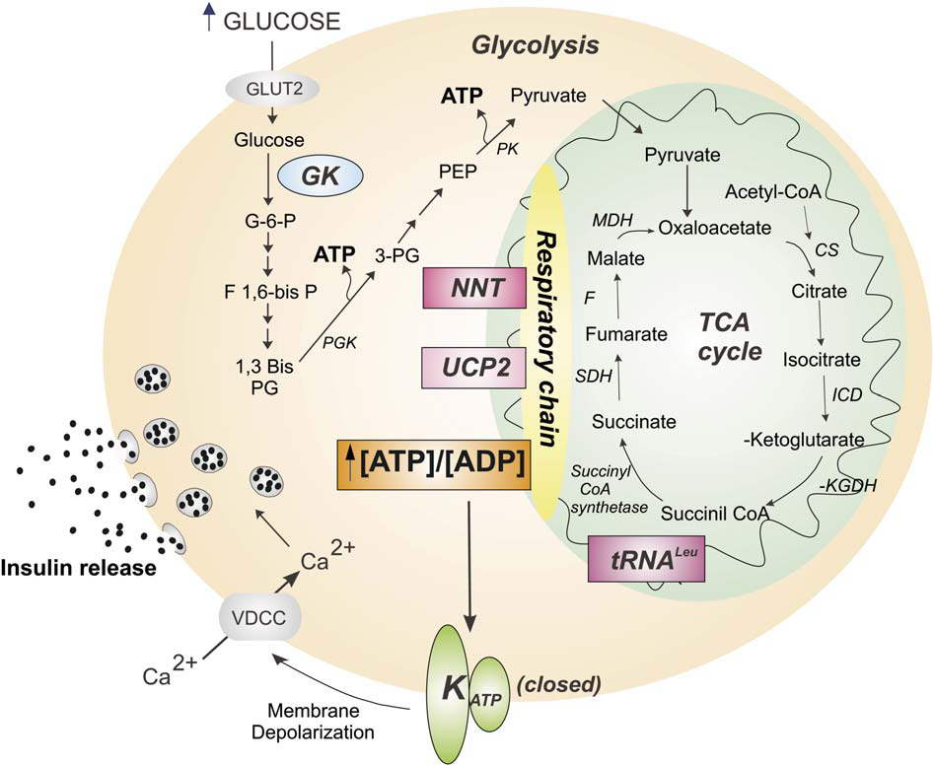
GLUT2 Km = 15 mM
GK Km = 10mM
GLUT3 Km = 1 mM
En cerebro
Cell Metabolism – January 2006

Slide 25
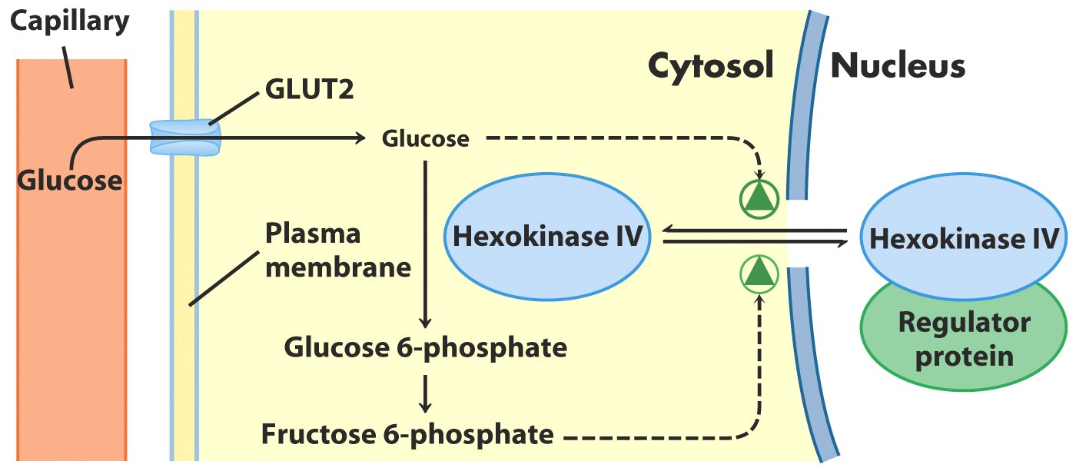
Glucosa, aumenta la actividad (compite con F-6-P)
F-6-P disminuye la actividad
F-1-P aumenta la actividad ¿diabéticos?
Km = 15 mM
15 mM
(4-5 mM)
F-1-P

Slide 26
Endocrine Reviews 20(6): 876–913 1999
Notes:
FIG. 14. Insulinotropic actions of GLP-1 on 􏰁-cells mediated by ac- tivation of the cAMP-signaling pathway. The binding of GLP-1 to its receptor (Re) activates adenylyl cyclase (Ac), resulting in the forma- tion of cAMP. Binding of cAMP to the regulatory (R) subunit of PKA results in the release of the active catalytic (C) subunit. The active kinase then translocates to the nucleus and phosphorylates, and therefore activates, the nuclear transcriptional activator CREB bound to the CRE located in the promoter of the proinsulin gene. This cascade of signaling results in a stimulation of transcription of the proinsulin gene and increased insulin biosynthesis to replete stores of insulin secreted in response to nutrients (glucose) and incretins (GLP-1, GIP). [Adapted with permission from J. F. Habener: In Di- abetes Mellitus, pp 68-78, 1996 (588)].

Slide 27
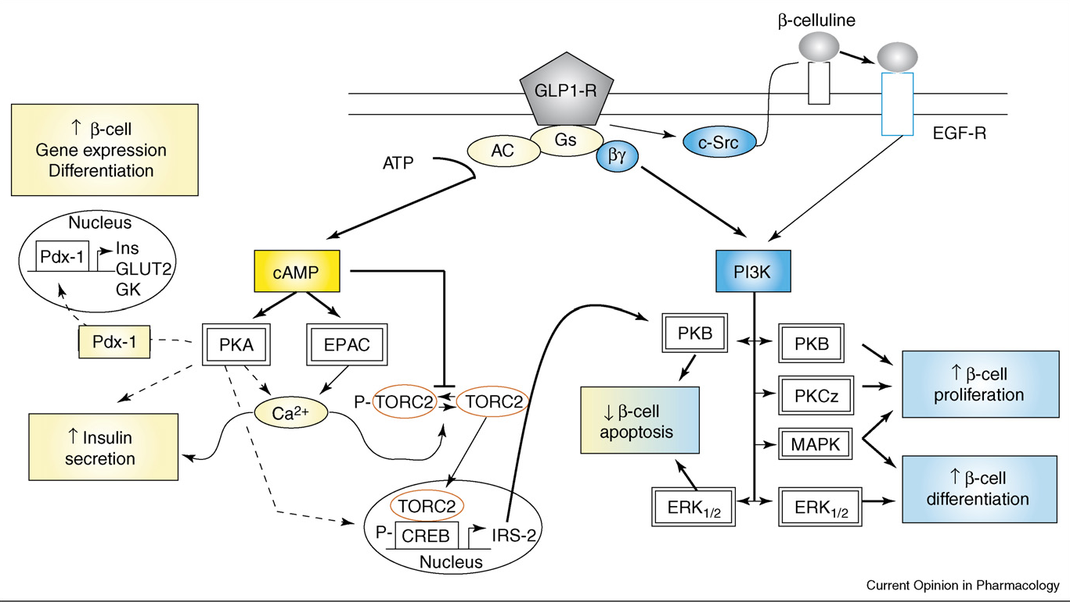
Binding of GLP-1 to its receptor in β−cells results in an increase in intracellular cAMP, leading to the stimulation of insulin exocytosis by two different pathways: PKA-dependent and PKA-independent (EPAC) [29]. GLP-1 also increases the activity of PDX1, leading to the regulation of gene expression. The anti-apoptotic effect of GLP-1 is mediated by the activation of CREB via the phosphorylation by PKA and its interaction with a coactivator named TORC2. To migrate into the nucleus, TORC2 is dephosphorylated via the synergistic activation of TORC2 phosphatase and inhibition of TORC2 kinase, mediated by calcium and cAMP, respectively [61]. Activated CREB enhances gene expression (e.g. IRS-2, which is involved in the activation of PKB) [44]. GLP-1 also activates the PI3K pathway by two distinct mechanisms: GLP-1 receptor activation of the Gs protein whereby the subunit dimer interacts with PI3K; and activation of c-Src followed by the liberation of an endogenous epidermal growth factor (EGF)-like ligand, b-celluline, which in turn activates the EGF receptor and increases PI3K activity [46]. PI3K subsequently activates its downstream targets MAPK, ERK, PKCz and PKB/Akt. In β-cells, PKC and MAPK activation are associated with GLP-1-induced proliferation, whereas ERK and MAPK activation leads to β-cell differentiation. Stimulation of PKB protects β−cells against apoptosis. AC, adenylyl cyclase; CREB, cAMP response element binding protein; EGF-R: epidermal growth factor receptor; GK: glucokinase enzyme; GLUT2, glucose transporter-2; Ins, insulin; IRS-2, insulin-receptor substrate-2; TORC2, transducer of regulated CREB activity.

Slide 28
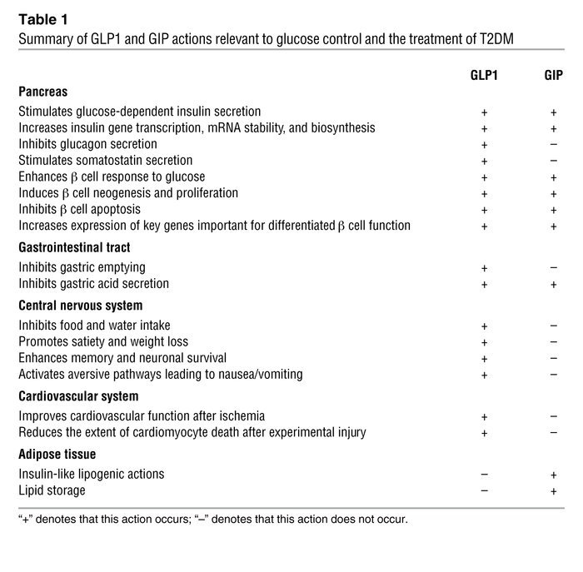
The Journal of Clinical Investigation Vol 117 January2007

Slide 29
GLP-1 targets multiple organs to improve glucose control in T2DM. GLP-1 acts directly and indirectly on several peripheral tissues that contribute to lowering of blood glucose levels. These include potent effects on the pancreatic βcell to stimulate insulin secretion, inhibition of α-cell glucagon secretion that reduces hepatic glucose production, a decrease in gastric motility, and a reduction in appetite that contributes to weight loss, reduced levels of adipocytokines, and decreased inflammation.
Endocrine Reviews, April 2012, 33(2):187–215
Notes:
GLP-1 targets multiple organs to improve glucose control in T2DM. GLP-1 acts directly and indirectly on several peripheral tissues that contribute to lowering of blood glucose levels. These include potent effects on the pancreatic 􏰊-cell to stimulate insulin secretion, inhibition of 􏰉-cell glucagon secretion that reduces hepatic glucose production, a decrease in gastric motility, and a reduction in appetite that contributes to weight loss, reduced levels of adipocytokines, and decreased inflammation.

Slide 30
Antiatherosclerotic potential of GLP-1 action. The direct actions of GLP-1 on blood vessels and macrophages and on the regulation of plasma lipid profiles may impact the development and/or progression of atherosclerotic plaques.
Endocrine Reviews, April 2012, 33(2):187–215
Notes:
Antiatherosclerotic potential of GLP-1 action. The direct actions of GLP-1 on blood vessels and macrophages and on the regulation of plasma lipid profiles may impact the development and/or progression of atherosclerotic plaques.

Slide 31
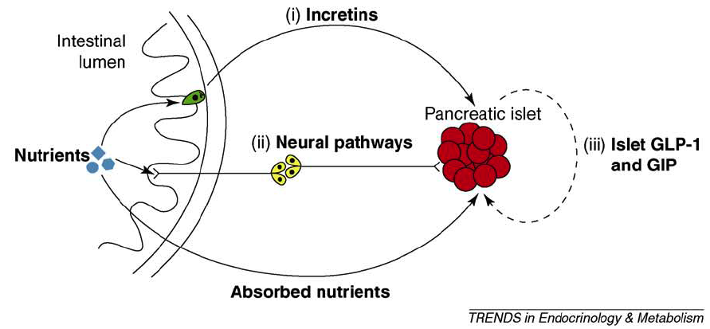
Impact of GIP/GLP-1 on islet hormone release. Nutrient ingestion triggers insulin release from islet β-cells via several mechanisms comprising the enteroinsular axis. (i) The intestinal incretin hormones GIP and GLP-1 are released from secretory granules in enteroendocrine cells (shown in green) and function as endocrine mediators of insulin secretion. Nutrient absorption from the gut lumen can directly activate insulin release via the bloodstream, and (ii) the presence of nutrients in the gut can also activate neural pathways (shown in yellow) that influence the secretion of islet hormones. Finally, in addition to enteroinsular mechanisms, release of (iii) islet GLP-1 and GIP might influence the growth, survival and function of islet cells (shown in red) through local paracrine and/or autocrine actions. The dashed arrow indicates ambiguity in this process.

Slide 32
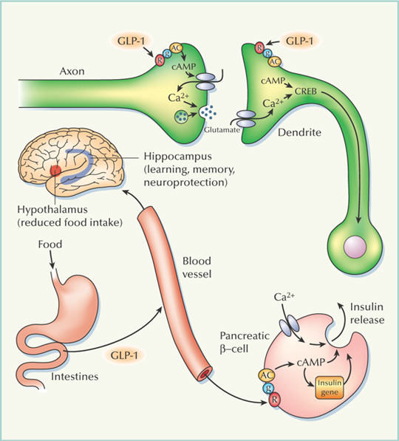
GLP-1 integrates energy metabolism, feeding behavior and learning.GLP-1 is produced by L-cells in the intestine and is released from those cells into the blood in response to food ingestion. GLP-1 binds to receptors (R) on pancreatic -cells, resulting in the activation of a GTP-binding protein (g) and adenylate cyclase (AC), thereby stimulating cyclic AMP production and calcium influx. Cyclic AMP and calcium stimulate rapid release of insulin from the cells and induce transcription of the insulin gene, thereby replenishing insulin stores. Insulin enhances glucose uptake by muscle cells; GLP-1 therefore has an antidiabetic action. GLP-1 also activates receptors in neurons located in the hypothalamus, resulting in a reduction in food intake; thus, GLP-1 has an important role in controlling energy balance. GLP-1 receptors are also located on neurons in brain regions, such as the hippocampus, that are involved in learning and memory. During et al. report that GLP-1 indeed enhances learning and memory. The exact mechanism is unknown, but GLP-1 might act on presynaptic axon terminals to enhance the release of glutamate, much like it stimulates insulin release from -cells. Alternatively, GLP-1 may bind to postsynaptic receptors in dendrites, resulting in activation of the cyclic AMP− and calcium-responsive protein CREB, a transcription factor known to have an important role in learning and memory.
Nature Medicine 9, 1113 - 1115 (2003)

Slide 33
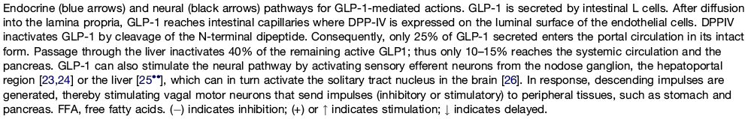
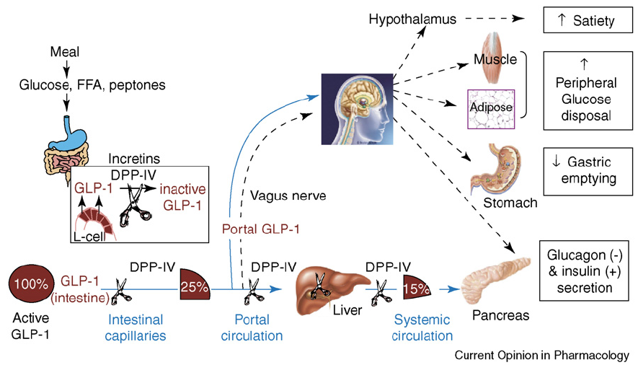

Slide 34
Familia de terapia basada en incretina
Terapias a base de
incretina
inhibidores DPP-4, por ej. sitagliptina, vildagliptina
agonista receptor de GLP-1
Terapias a base de
exendina, por ej. exenatida
Análogo de GLP-1
humano, por ej. liraglutida
Byetta® Lilly
(Victoza® Novo)
Notes:
Familia de terapias a base de incretina
Las terapias a base de incretina puede dividirse ampliamente entre:
Inhibidores DPP-4 (por ej. sitagliptina, vildagliptina)
agonista receptor de GLP-1 (Exenatida, liraglutida)
Con esta segunda categoría sin embargo, los agonistas de GLP-1R pueden ser clasificados como:
Terapias a base de exendina (exenatida, exenatida LAR) cuya secuencia es idéntica en ~50% con el GLP-1 humano
Análogos de GLP-1 humano (liraglutida), con un porcentaje muy superior de similitud con GLP-1 humano (97%)
34

Slide 35
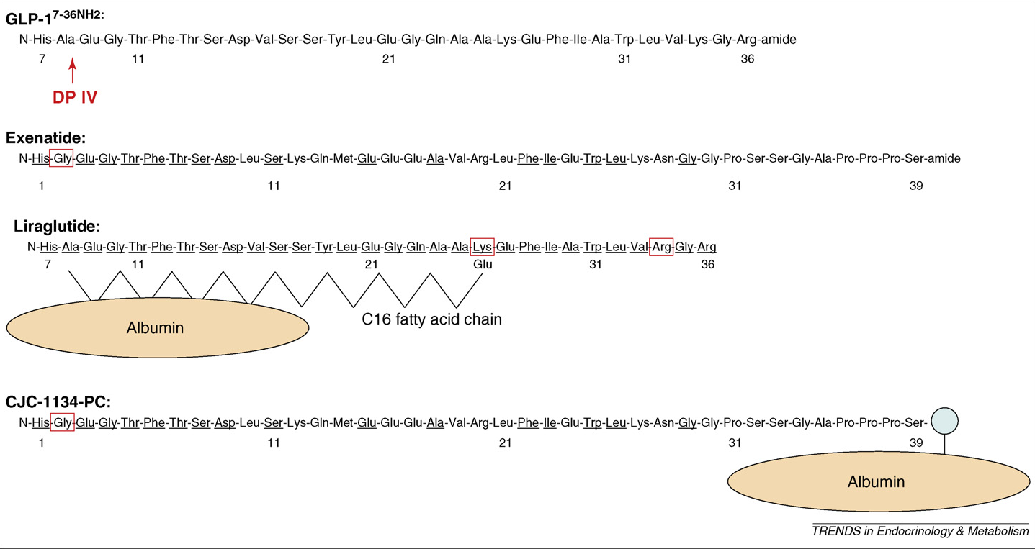
Structural similarities and differences between GLP-1, exenatide, liraglutide and CJC-1134-PC
Versión sintética de exendine-4 ( en 2012 una semanal)
97% analogía secuencia
Se libera lentamente de la albumina (t_{1/2} = 11-15h)
No induce hipoglucemia (dependiente conc. Glucosa)
Proteína hibrida recombinante. Vida media mas larga

Slide 36
SDF-1 = Citoquina activadora de Linfocitos
BNP (1-32) = Péptido implicado en presión sanguínea
NPY (3-36) = Neuropeptido
PYY (1-36) = Péptido liberado de Ileon y Colon. Reduce el apetito
Endocrine Reviews, April 2012, 33(2):187–215

Slide 37
Endocrine Reviews, April 2012, 33(2):187–215

Slide 38
Endocrine Reviews, April 2012, 33(2):187–215

Slide 39
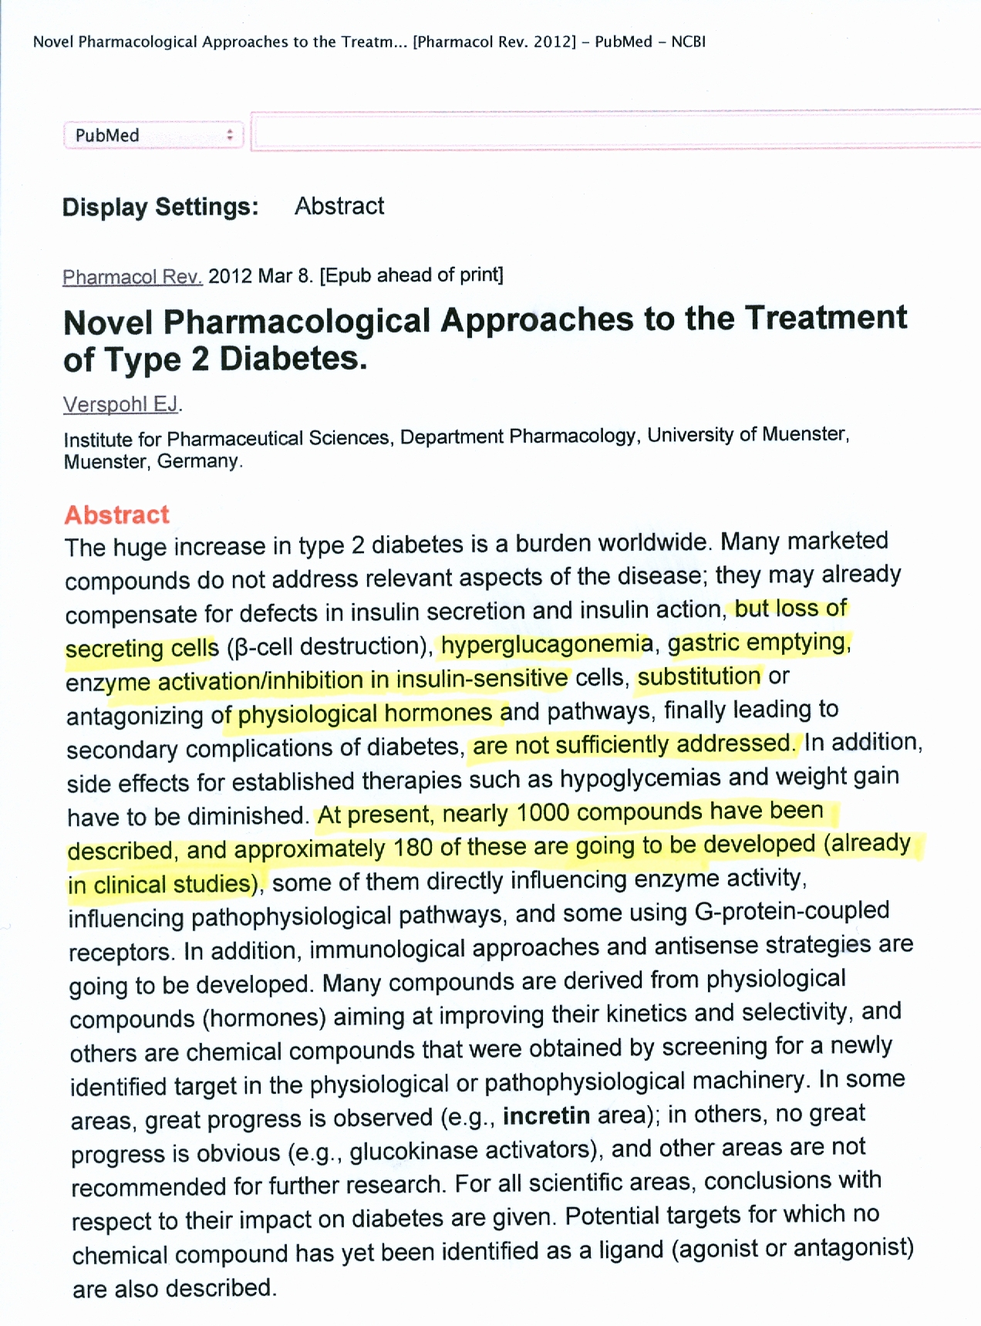

Slide 40
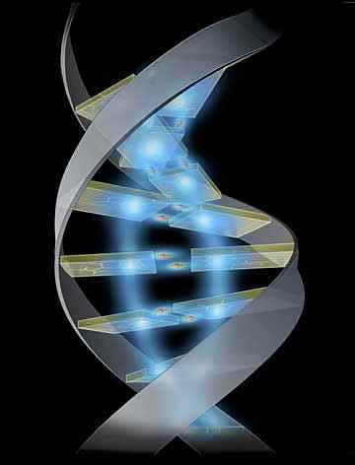

El guardian del genoma dice……..
¡¡¡¡Ave….mus acabadus!!!!

